Slide 1
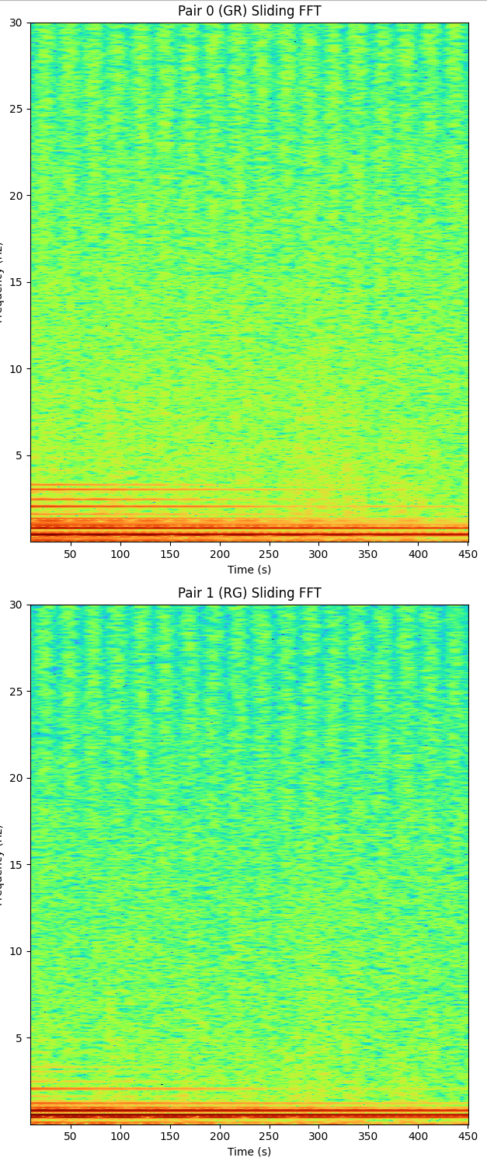
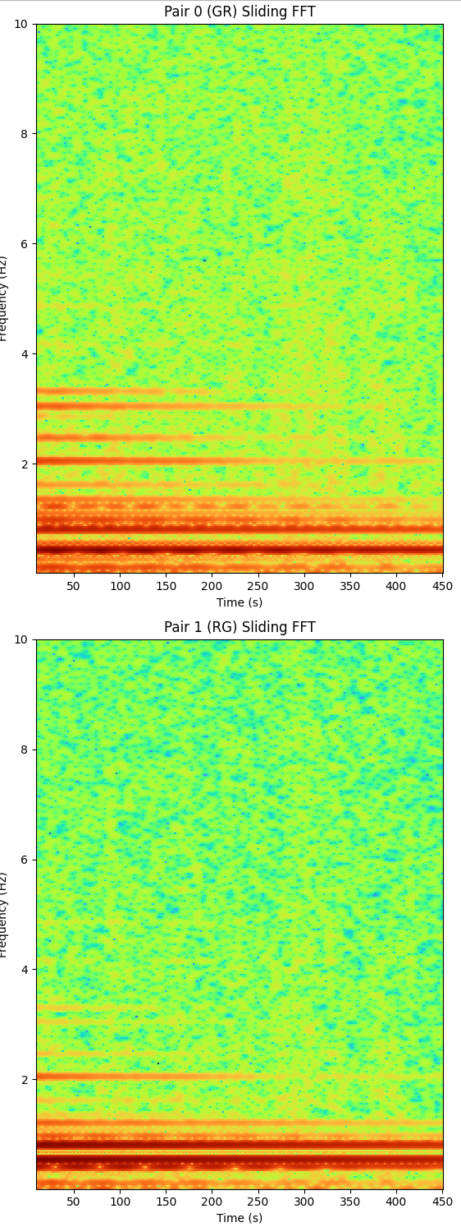
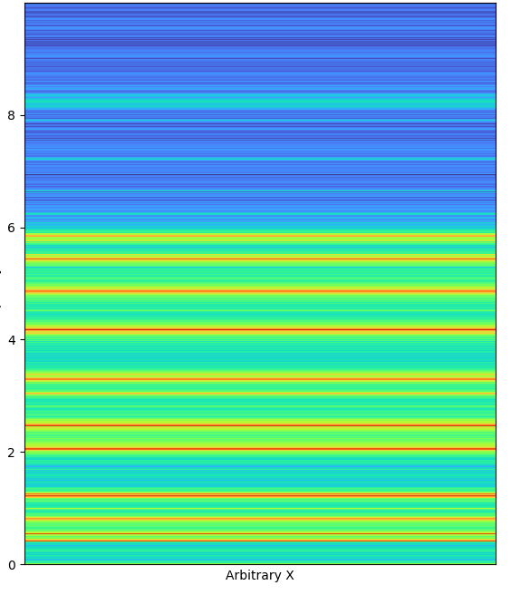
IMG_0560, no driving, essentially ‘pure’ (as close as we’ll get to that, but of course, coupling, etc) sheer modes seen. (trivial case). Unless it also has some pitching, but they seem too spectrally bright given that I don’t think we can really see them in the video. We need to test more.

